Slide 1
2.IONIC LOCALDB SQLITE
Khirulnizam Abd Rahman

Slide 2

Agenda
Create new Ionic Project
FormGroup to gather input data
SQLITE Ionic Plugins
Fetch Dummy data
Insert new Data/Record
Display Records

Slide 3
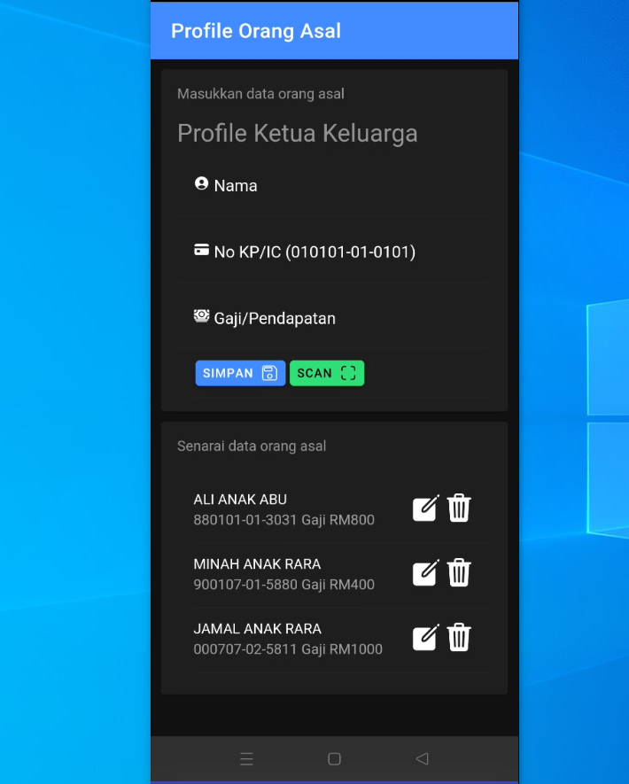
Output/ overview

Slide 4
CREATE NEW IONIC PROJECT
ionic start profilorangasal

Slide 5
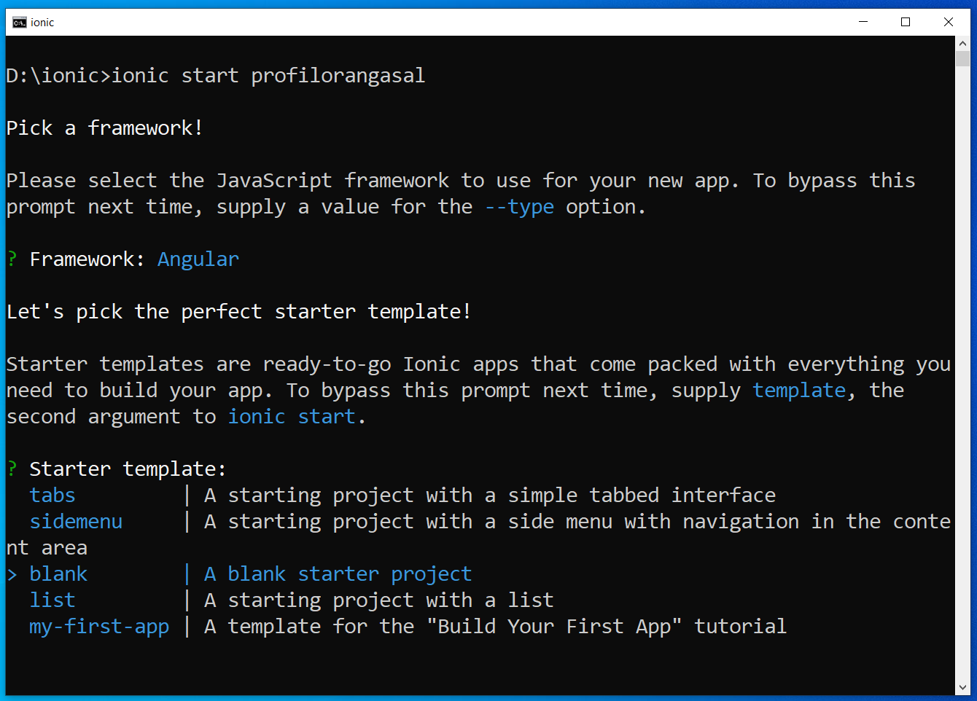
Create new ionic project

Slide 6
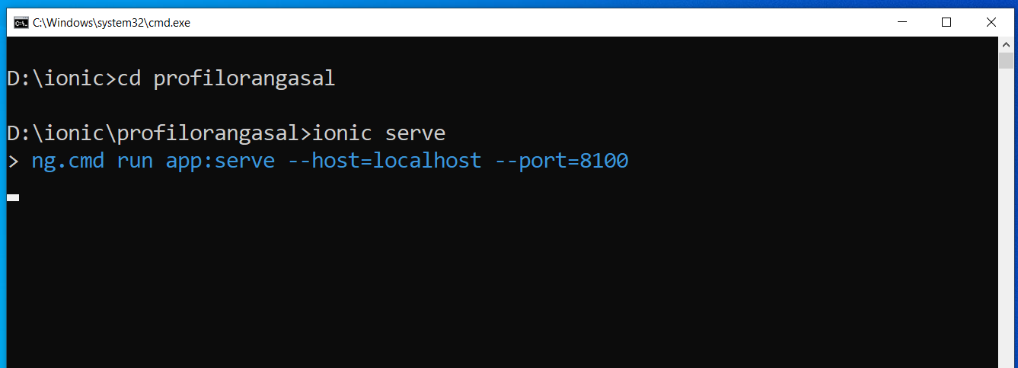
ionic serve

Slide 7
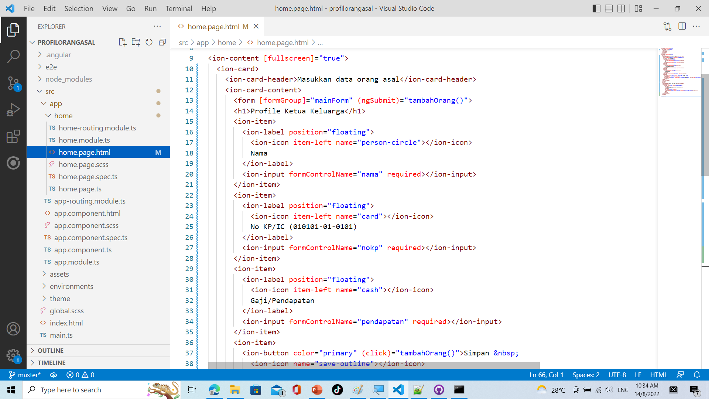
home.page.html

Slide 8
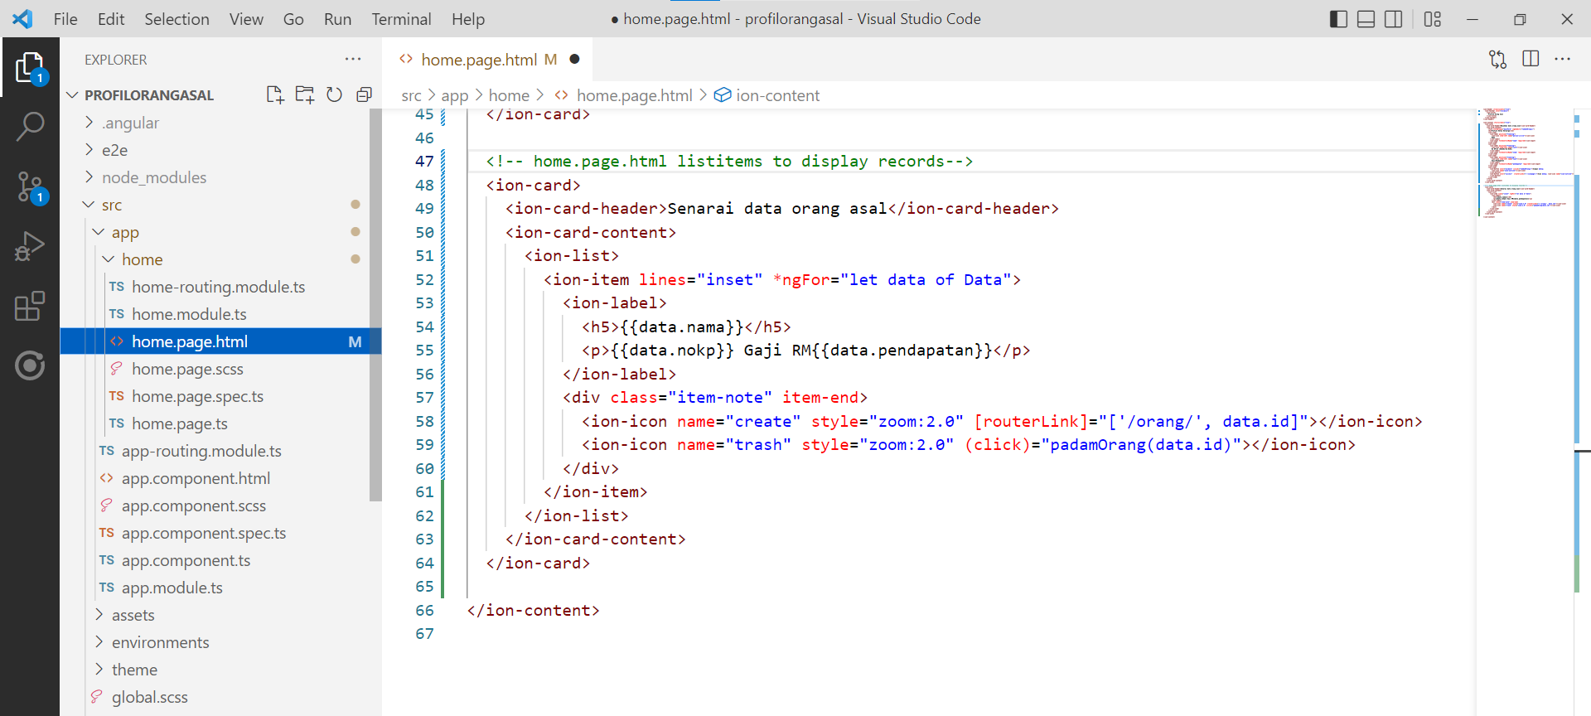
Cont… home.page.html

Slide 9
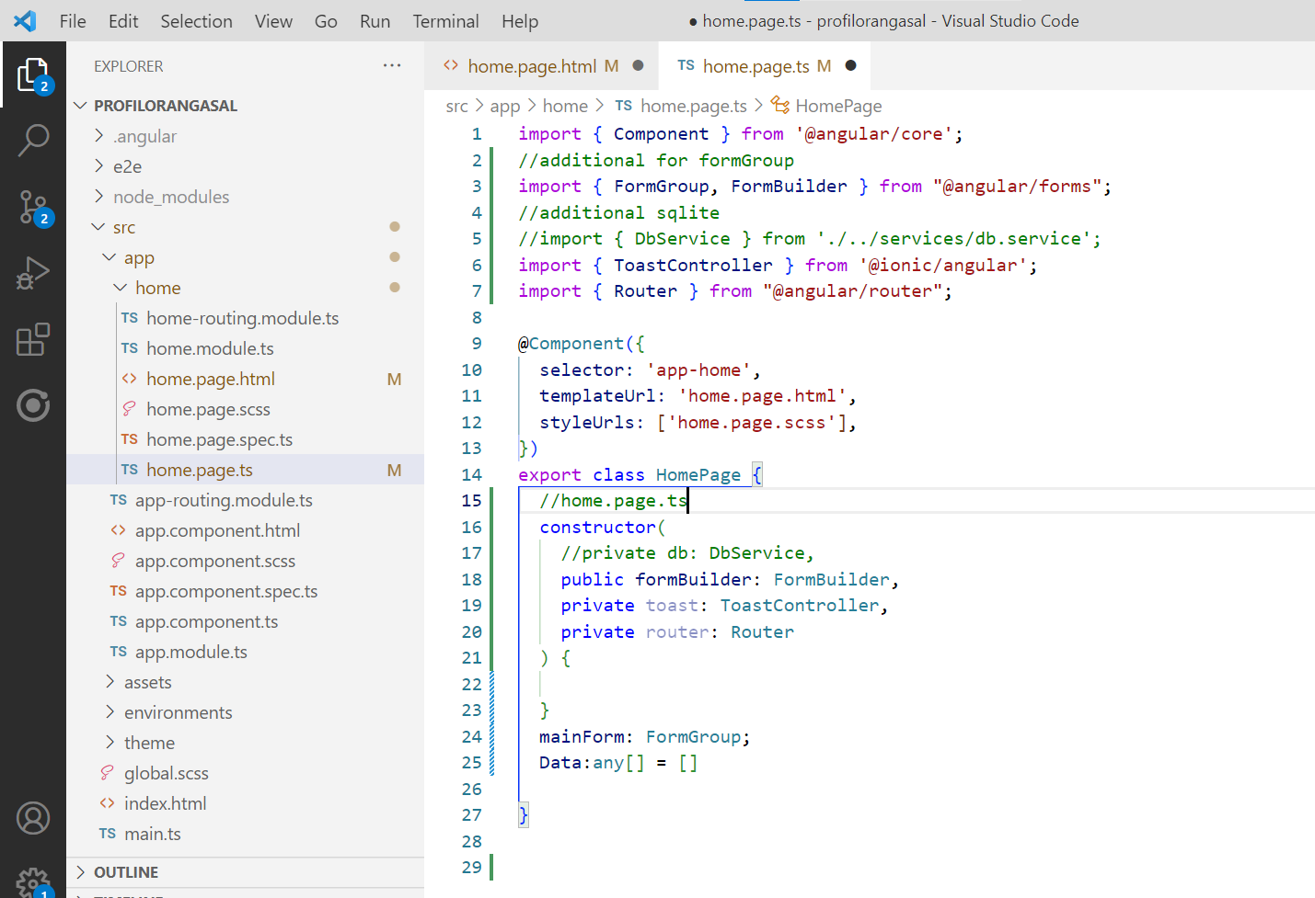
home.page.ts

Slide 10
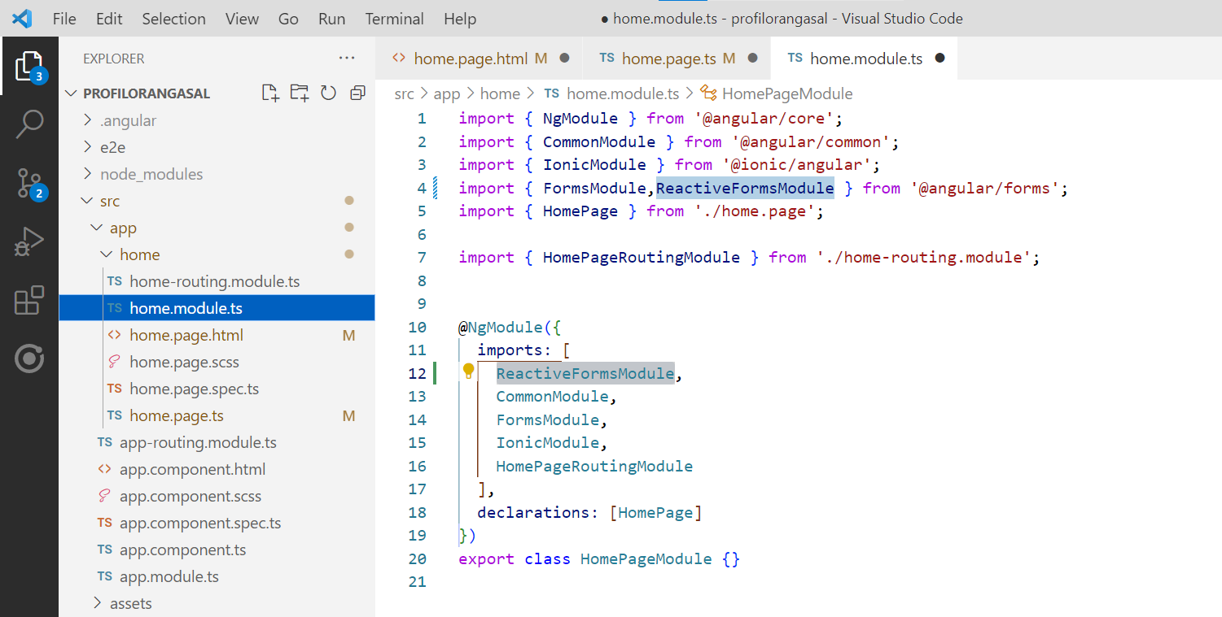
home.module.ts

Slide 11
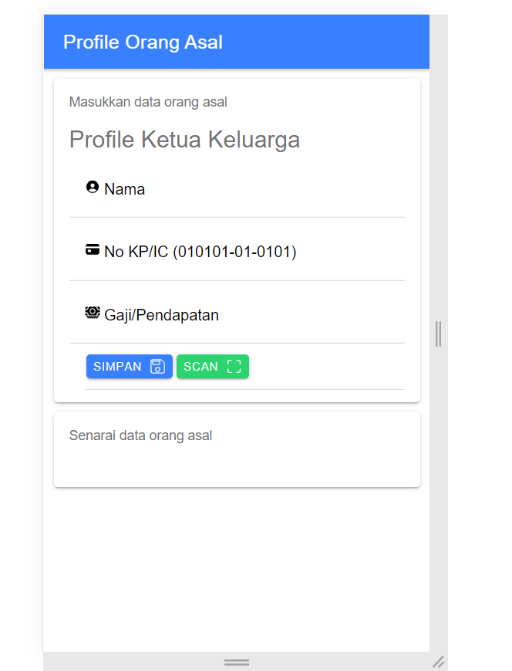
Output home.page.html

Slide 12
PREPARING THE DATABASE STRUCTURE IN SQL
sqliteonline.com

Slide 13
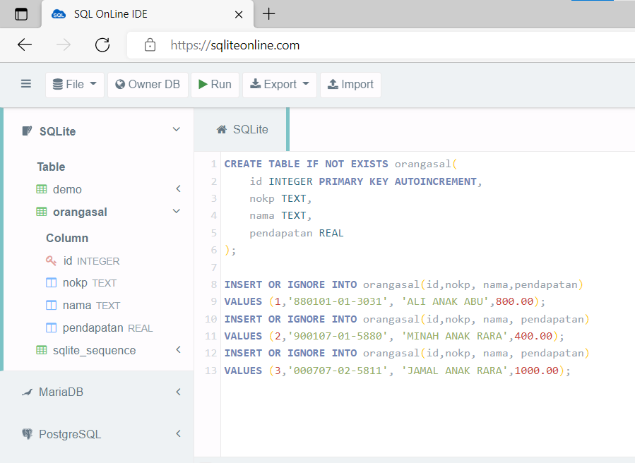
Write & test sql sqliteonline.com

Slide 14
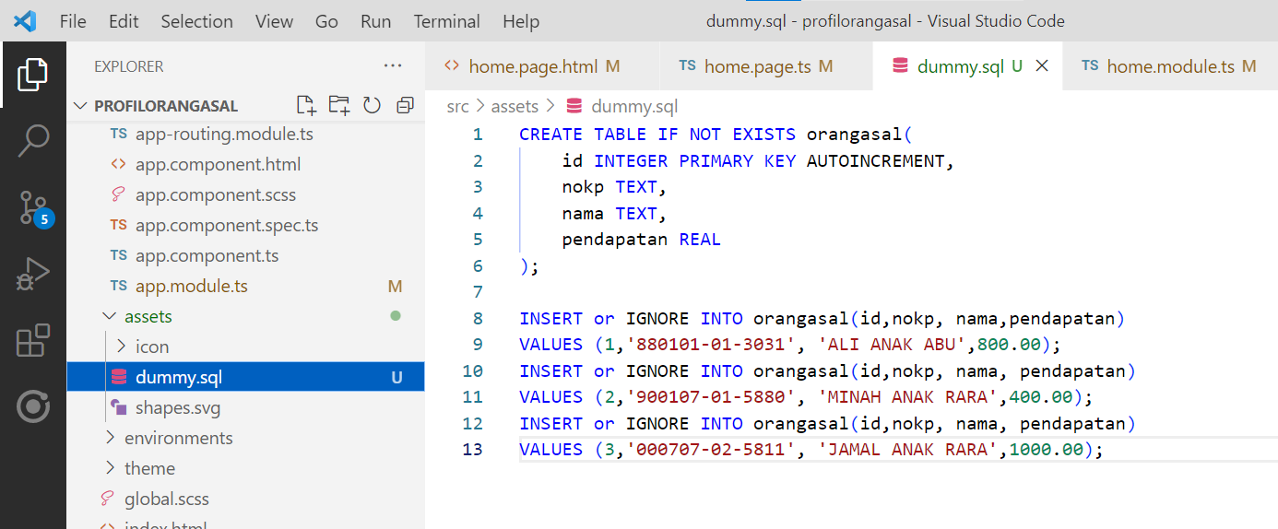
Put in assets/dummy.sql

Slide 15
SQLITE PLUGINS
SQLite

Slide 16
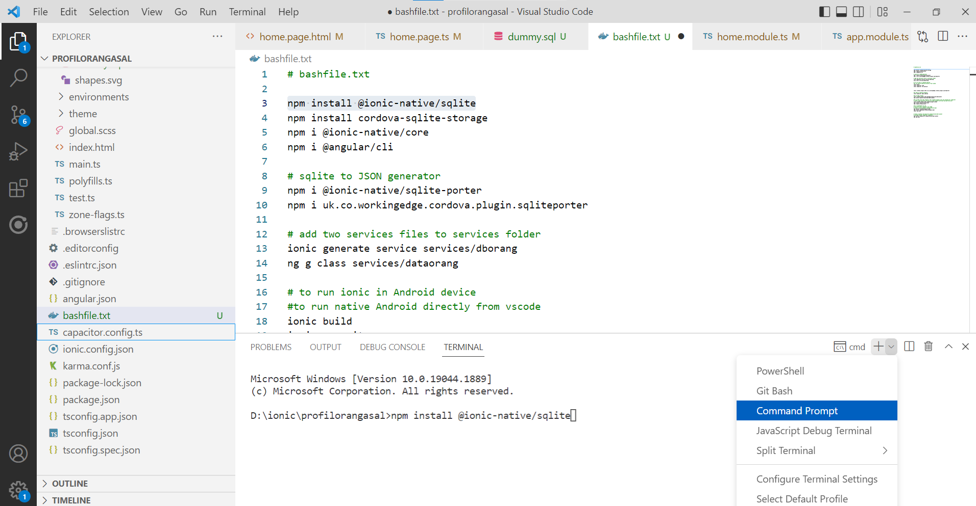
Install these plugins in cmd

Slide 17
Install these ionic plugins
npm install @ionic-native/sqlite
npm install cordova-sqlite-storage
npm i @ionic-native/core
npm i @angular/cli
npm i @ionic-native/sqlite-porter
npm i uk.co.workingedge.cordova.plugin.sqliteporter

Slide 18
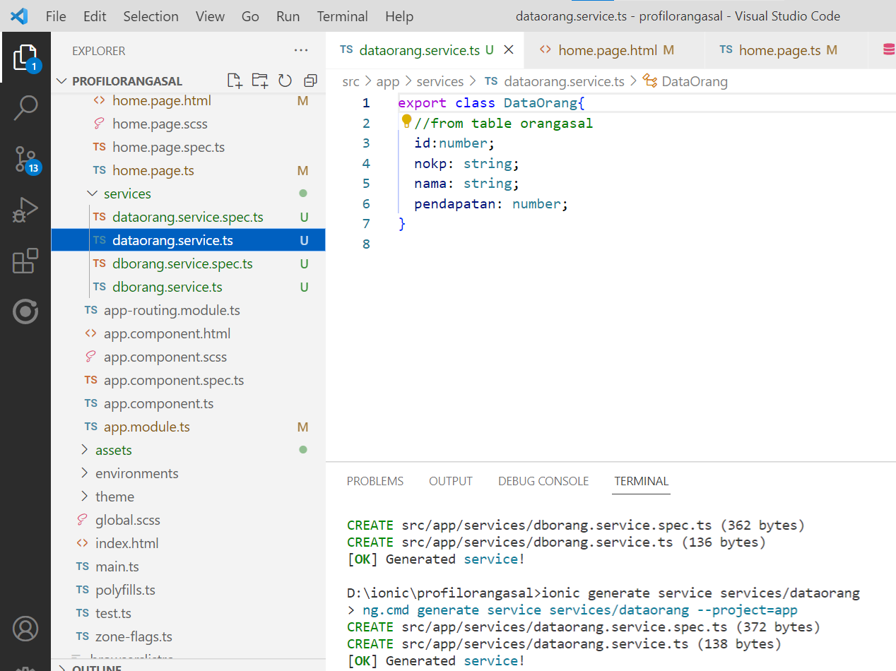
Create these services
ionic generate service services/dataorang

Slide 19
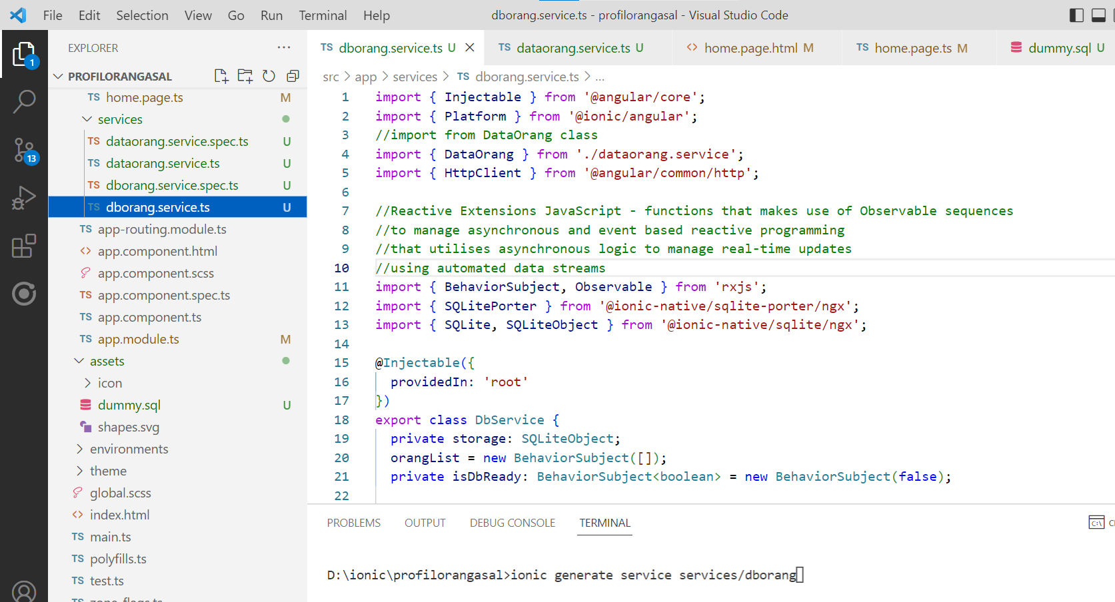
DbOrang services

Slide 20
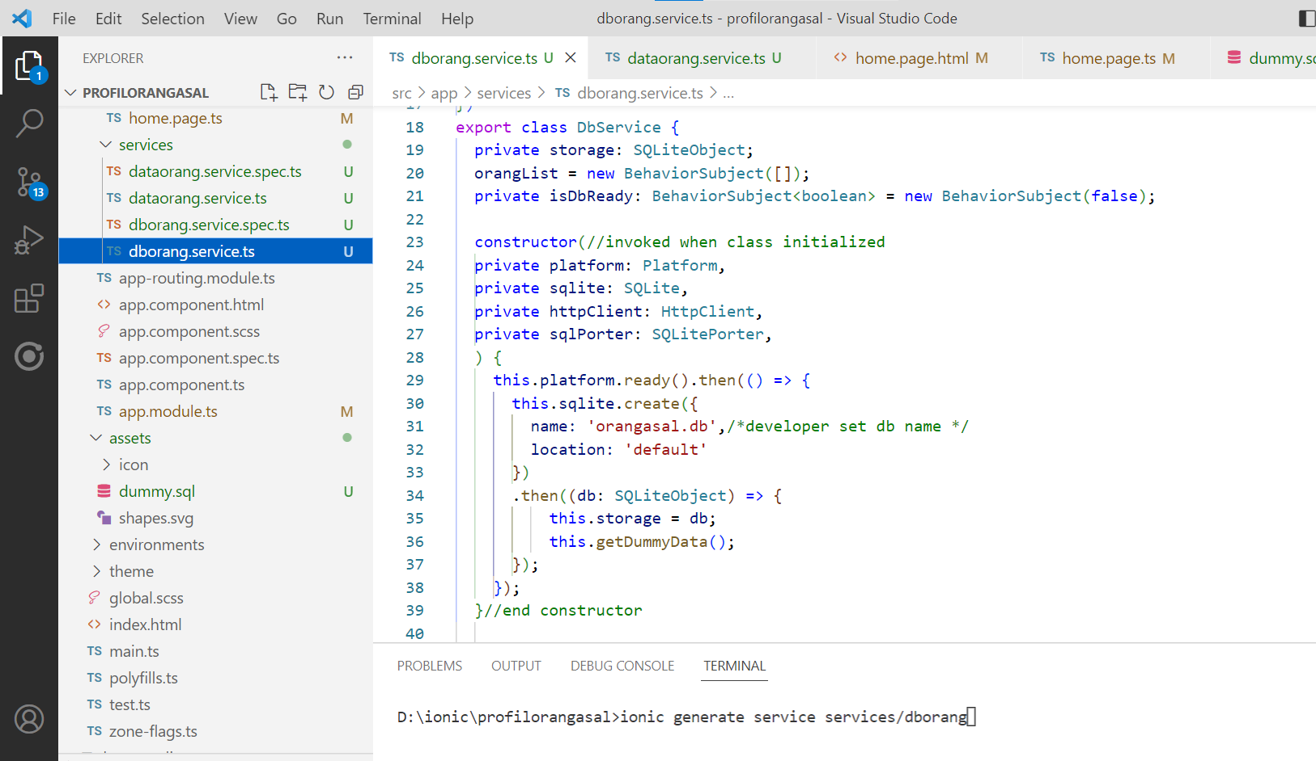
DbOrang service constructor

Slide 21
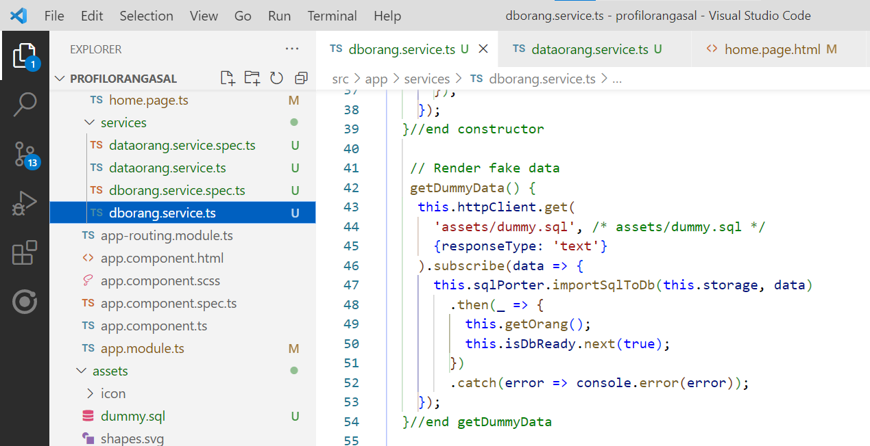
DbOrang service getDummyData

Slide 22
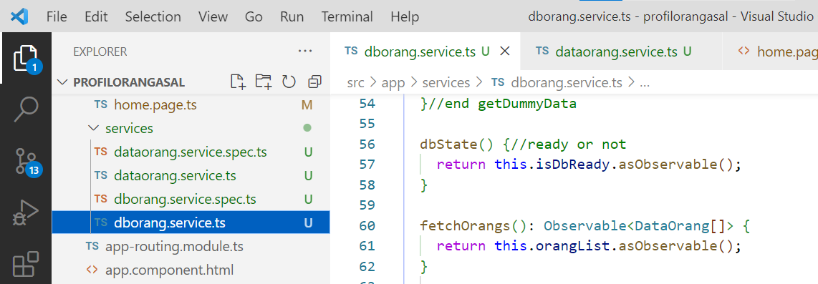
DbOrang service fetchOrangs

Slide 23
DbOrang service fetchOrangs

Slide 24
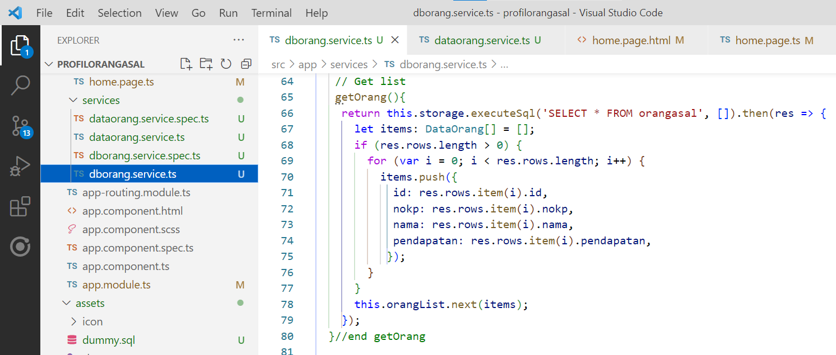
DbOrang service getOrang

Slide 25
DbOrang service getOrang

Slide 26
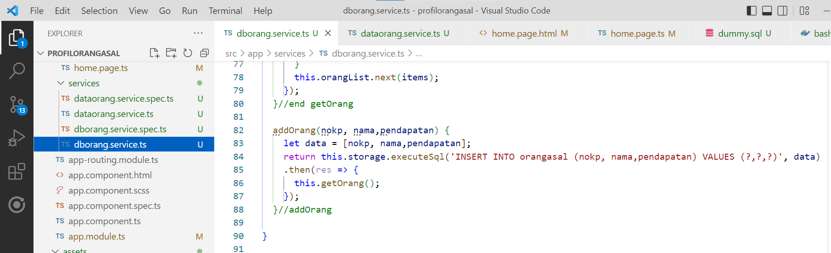
DbOrang service addOrang

Slide 27
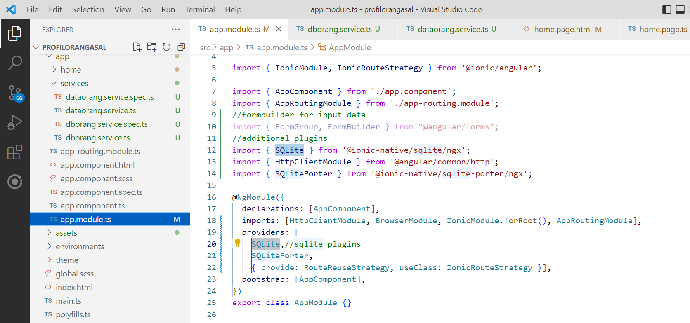
App.module.ts

Slide 28
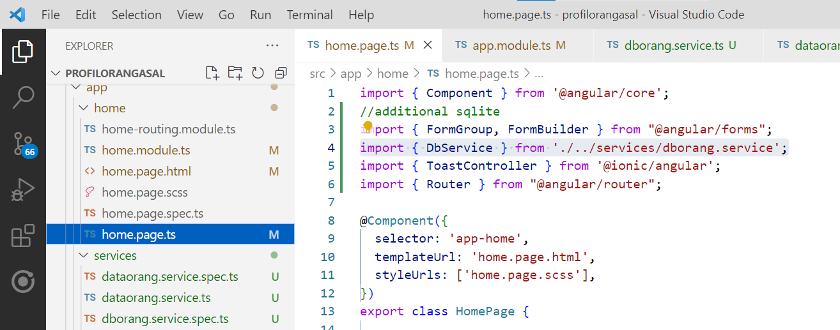
home.page.ts
imports

Slide 29
home.page.ts imports
imports

Slide 30
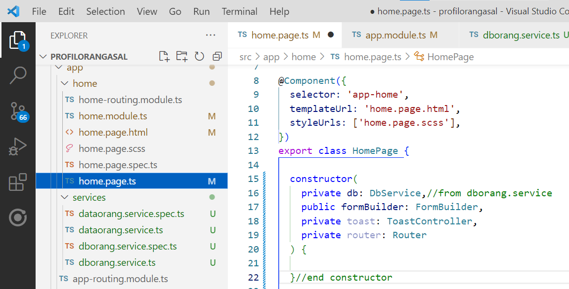
home.page.ts constructor

Slide 31
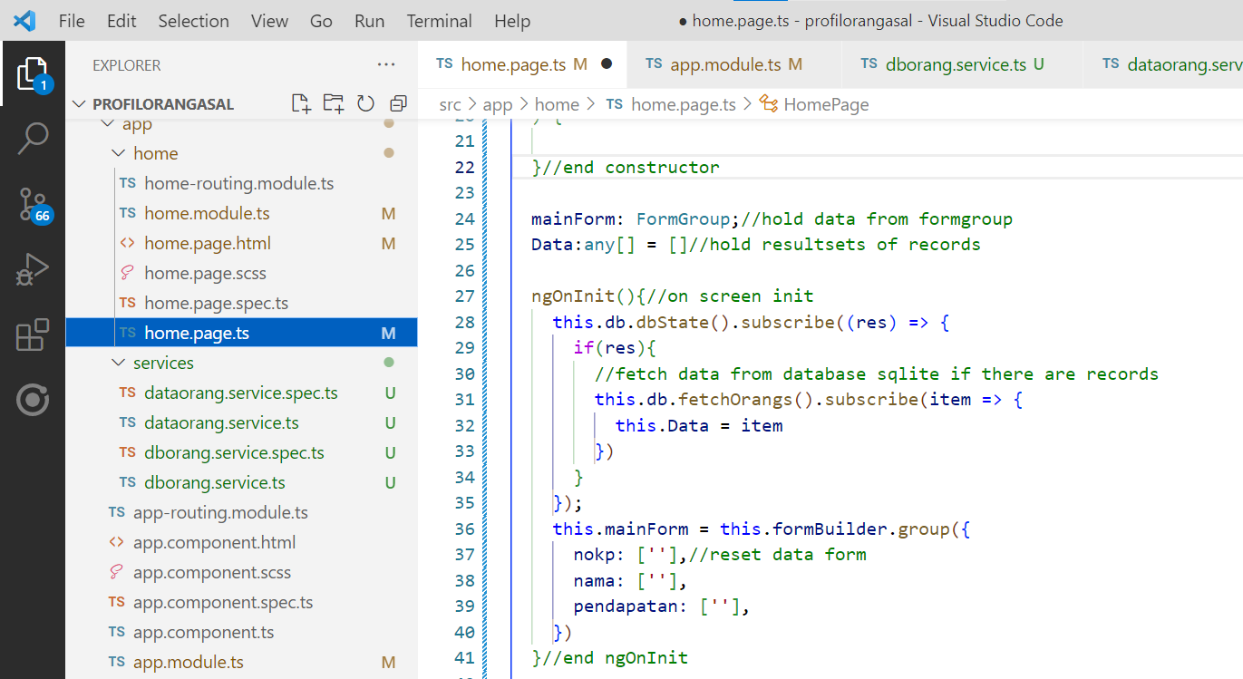
home.page.ts ngOnInit()

Slide 32
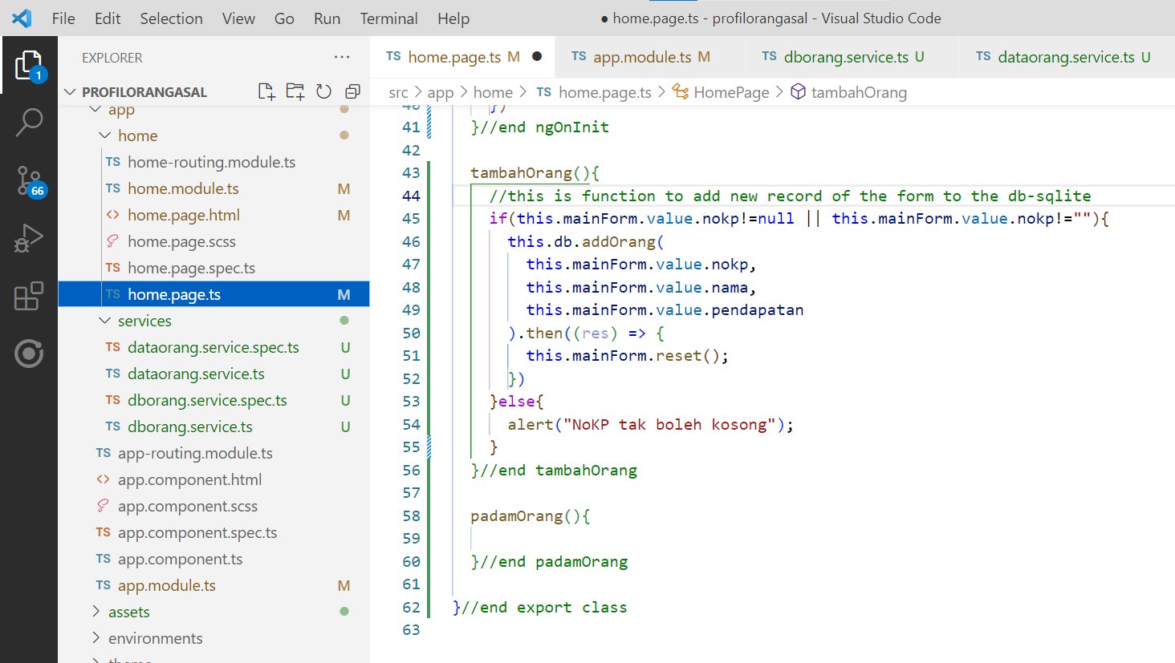
home.page.ts tambahOrang()

Slide 33
Test on Android device
#to run native Android directly from vscode
ionic cap add android
ionic build
ionic capacitor copy
ionic capacitor run android

Slide 34
Output

